Slide 1



Serilog
The best logging library for .NET you’ve never heard of
Daniel Plaisted
.NET Framework
daplaist@microsoft.com
@dsplaisted

Slide 2

Serilog
The best logging library for .NET you’ve never heard of
Daniel Plaisted
.NET Framework
daplaist@microsoft.com
@dsplaisted

Slide 3

Are you satisfied with your current logging solution?
Notes:
Friends, I have a very simple question for you today…

Slide 4
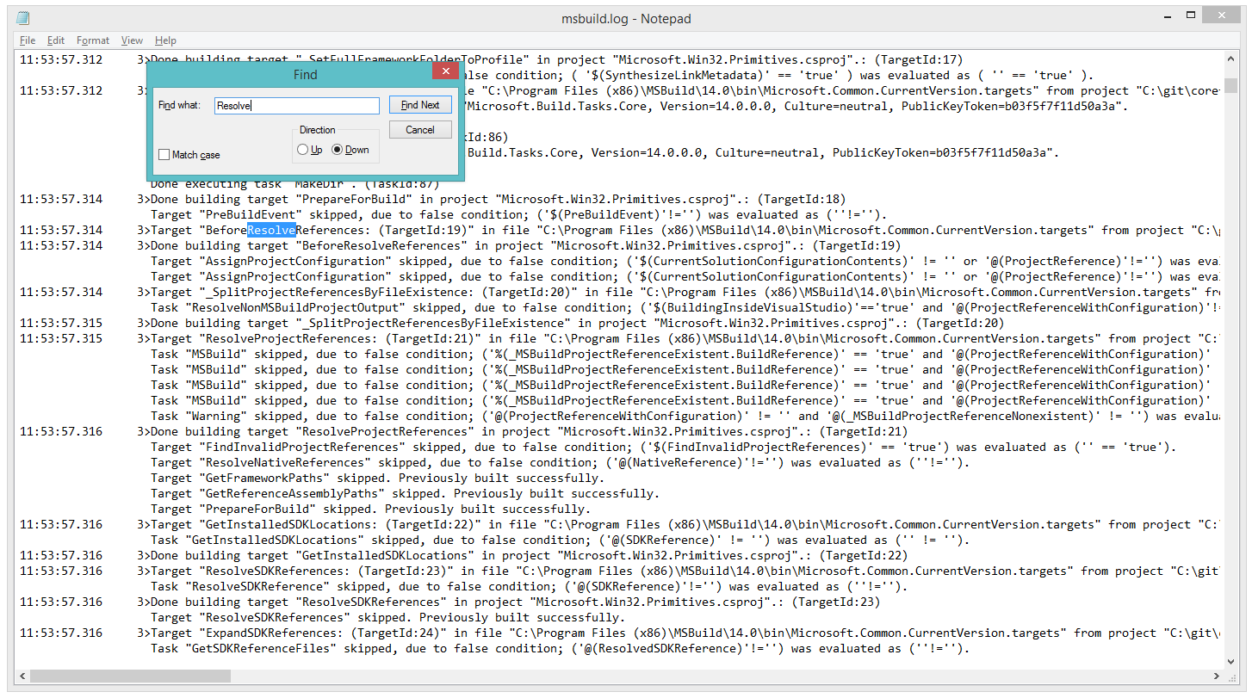
Have you been frustrated trying to make sense of thousands and thousands of lines of log files?

Slide 5
Are you forced to use
global configuration…
LogManager.Configuration = config;
…and static state?
_logger = LogManager.GetLogger(
typeof(MyClass).FullName);

Slide 6

Do you long for an intuitive, elegant logging API?

Slide 7

Notes:
Have you said to yourself, “There’s got to be a better way!”?

Slide 8
Simple API that is a joy to use
Structured data to preserve your data’s semantics
Can log to any target you can imagine

Slide 9


Notes:
How much would you pay for a library like this? $500? $5,000?

Slide 10

Notes:
ONE MILLION DOLLARS?

Slide 11
Serilog
Act now!
Absolutely free!
serilog.net
github.com/serilog/serilog
www.nuget.org/packages/ serilog

